Slide 1
雲端計算
Cloud Computing
Cloud Issues and Challenges
Security

Slide 2
Agenda
Introduction
  Issues & challenges
Cloud Security
  Security & attack
Cloud Standard and Law
  Guideline for secure cloud
  Law and privacy

Slide 3

Cloud Computing
Cloud computing collects all resource and all data in the same place
  Centralization increases the efficiency of management.
Cloud computing provides many useful and interesting services
  Hundreds of thousands of users access services.
But, cloud computing also attracts the attention of malicious users.

Slide 4
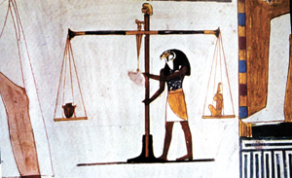
Cloud Computing (cont.)
End users or companies want the benefits of using cloud computing
  They also worry about the disadvantage of cloud computing.
  Vendors propose many benefits and advantages, but never mentioned any possible harm.

Slide 5
Viewpoints
Companies have large of data that cannot be disclosed to others
  Finances reports
  Consumers list
  New product and novel technical
  …etc
Data leakage could lead to economic loss or legal proceeding

Slide 6
Viewpoints (cont.)
End users may not want to let other know too much
  Family members
  Phone numbers
  Salary
And some important information should be kept secret
  ID number
  Credit card number
  Bank account
  …etc

Slide 7
Questions
Before jump into cloud computing, following questions consumer may ask
  What’s the security strategy?
  How to prove the reliability and security that vendor claimed?
  Can someone access my data without my permission?
  Who is responsible for policy distribution, management and control?
  What are the emergency response measures and compensation mechanisms?

Slide 8
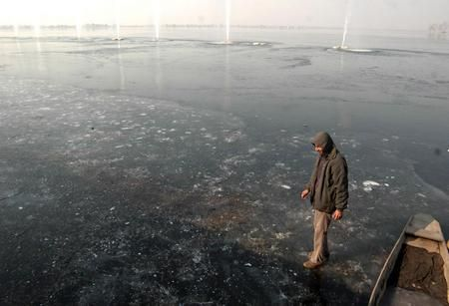
The Real World is ?
System may crash caused by incorrect operation.
Sensitive information data may be stolen caused by loose access management.
Network may break caused by someone theft cable.
…

Slide 9
Compass
When we invested in the cloud computing
  How to build the secure cloud environment or platform?
  How to maintain the cloud service?
  How to migrate from one cloud vendor to another safely and painless?
There are many key issues for cloud security
  Data protection, service quality guarantee, disaster recover …etc.
  Customers need a guideline to search a secure cloud vendor.
  Cloud vendor also need a guideline to build a secure cloud environment.

Slide 10
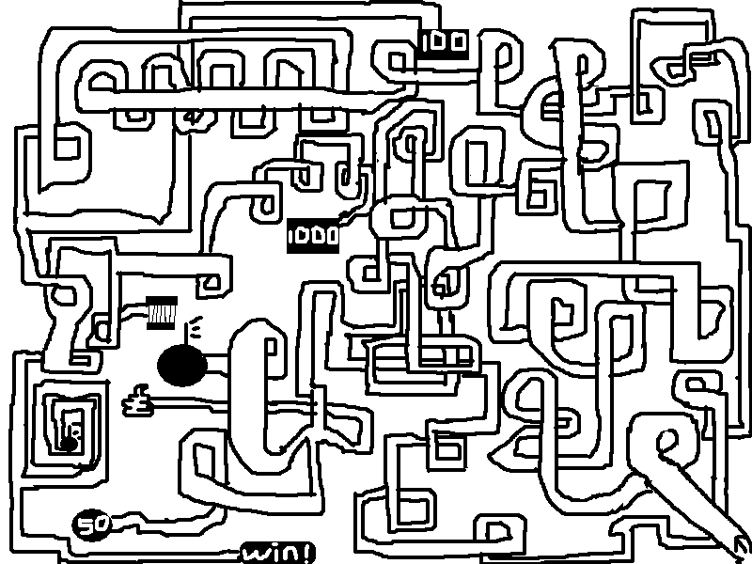
Loss of Direction
When the cloud companies or customers loss of direction on cloud security
  They may pay lots of money and resource on the useless efforts.
  They may pay lots of money and loss the intangible assets on the unsecure cloud services.

Slide 11
Remaining
Introduce the cloud security and issue
  There are lots of attacks in Internet, and cloud computing still can not escape.
  Some properties of cloud would avoid some attacks, but some properties could increase the scope of damage.
Introduce the cloud standard, law and privacy issue
  The cloud security standard classify the security issues and provides the security suggestions.
  Given two security examples between law and privacy.

Slide 12
Agenda
Introduction
  Issues & challenges
Cloud security
  Security & attack
Cloud standard and law
  Guideline for secure cloud
  Law and privacy

Slide 13
Cloud Security and Issues

Slide 14
Outline
Introduction
Attack scenario
  Attack method and possible solutions
  Real case in the world
Summary

Slide 15
Introduction

Slide 16
Security
Security is the degree of protection against danger, damage, loss and crime.
  Security is focused on hardware mechanism, software vulnerability and information hiding.
  Malicious attackers wants to steal data or destroy system
Security evolution can be divided into three parts
  Secure technique
  Secure management
  Cyber security

Slide 17
Secure Technique
Original security that provides the basic protection mechanism
  Authorization specifies the access right to resource and reject the request from the unknown user.
  Encryption makes information unreadable to anyone except those possessing special knowledge.
  Uninterrupted power supply (UPS) and remote backup server avoid the data lose or server interrupt cause by natural disasters.

Slide 18
Secure Management
Proposed and executed one or more feasible security policy
  Access-control-policy is high elasticity that authorizes a group of users to perform a set of actions on a set of resources.
  Some sort of industry guidelines train and teach employee the computer security concept.
  Incident response plans are the standard procedures for dealing with emergencies

Slide 19
Cyber Security
Internet now is a new battlefield that everyone in Internet everyday
  Intrusion prevention system (IPS) monitor, identify and log information network and/or system activities for malicious activity.
    Attempt to block/stop activity, and report immediately.
  Social engineer is manipulating people into performing actions or divulging confidential information, rather than by breaking in or using cracking technique.

Slide 20
Information Security
Information security means to avoid to access, record, disclosure, modify and destruct without authorizing.
There are three core principles of information security
  Confidentiality
  Integrity
  Availability
Confidentiality
Availability
Integrity

Slide 21

CIA
Confidentiality
  User access the sensitive data only when getting the permission.
  Data or information could be separated into several secure level
    Normal, security or top secret.

Slide 22
CIA (cont.)
Integrity
  Data cannot be modified undetectably.
  Information keeps accurate and complete during transmission.
Availability
  User can get all data what they need anywhere and anytime.

Slide 23
In Real Life
Users or companies would skip the confidentiality
  The convenience is more important than the secret.
  High confidentiality needs complexity passwords and change frequently.
  Confidentiality also keeps principle of least privilege, that increase use of the convenient.

Slide 24
Unbalance…
When convenience and confidentiality is not balanced anymore
  Everyone will leave since environment is not friendly.
  Everyone will leave since user no longer have secret.
Service vendors try to give the optimal solution
  A novel authentication method
  A perfect access control mechanism
  An immediate emergency response program
  …

Slide 25
In Cloud Computing
Properties of cloud computing reduce the part of security issue
  The property of availability provides the services anytime and reduce the probability of downtime.
  The property of scalability avoids the starvation of resource and can accommodate a large number of users.
But cloud computing still need to maintain a high degree of attention on security

Slide 26

To be a Sheep?
Cloud computing provides services to everyone
  There are a lot of sensitive information.
  User do not want any delay or stop service.
  Cloud vendor want to more and more users to use cloud service.
But someone also think this is a business.

Slide 27
Attack scenario

Slide 28

Malicious Attacker
Malicious attackers hide in Internet and try to
  Steal the important or sensitive information
  Collect user’ data and sell these
  Control or destroy the compromised system
  Raise awareness
Focus on the attackers’ motivation.
  Money
  Philosophy
  Show off

Slide 29

Hacker Economic
How much of your personal information
  Name, phone number and address
  ID number
  Credit card number
  …etc
But the price of data have been reduced day of day
  Hacker must work hard
  Automation
  Large deployment
  …etc

Slide 30
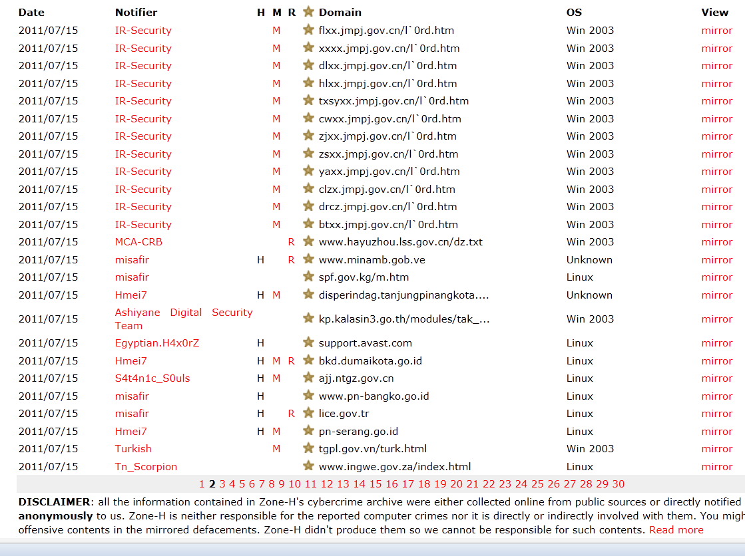
Fun or Show Off
Hackers may want to get some pleasures or show their special talent
  Hackers attack those websites what they don’t like.
  Patriotic hackers change the home page and show some message.

Slide 31
How to Attack?
How does hacker attacks the system or steal some information?
Hacker is not the God
  Still need some background and practices.
  Still need to prepare some preprocess work.
  Still need some tools.
There are two parts of attack behavior
  Penetration
  Attack and destroy

Slide 32
Workflow
Penetration
  Collect all public information.
  Try to find the weakness or vulnerability.
  Try to get the access right or administrator privileges.
Attack and destroy
  Steal or delete data
  Crash the system
  Monkey business

Slide 33
Penetration
Hacker finds the weak point to access the target server and leave without trace
  Weak password or SQL injection
  Program vulnerability
  Erase all log file
Penetration test (also called pentest) is a method of evaluating the security
  Simulate an attack from a malicious source.
  Analysis the feasibility of an attack and guide improving the system security.

Slide 34
Attack and Destroy
Hackers try to steal data, block service and destroy system
  Compared with penetration, attacks do not need to be hidden.
  Paralysis of the operational capabilities of the host and the firewall.
  Install malicious code to destroy the system and data.
Attack action may be accompanied by penetration.

Slide 35

In Cloud
Penetration is the already accustomed to things
  The server in Internet would suffer hundreds of attacks
  Ping and port scan
  Try to log in or get the correct password
Cloud computing also collect ten to hundreds PB information per days
  Hacker may get millions of information with a successful attack.
  Malicious attack will not stop.

Slide 36
Methods
Cloud computing environment is also a group of computers
  Old attack methods can still pose a threat in some case.
  But some methods cannot damage system anymore.
Cloud properties can reduce the probability of the system under attack
  Scalability
  Accessibility
  Management
  …

Slide 37
Attack scenario
Burst force
Phishing
Sniffer
DDoS

Slide 38

Password
In general, password is the basic method for authentication
  Length of password and characters determine the strength of security.
  Only lowercase with 4 characters has 45,000 possibilities.
  Common words can be crack in few minuets by dictionary attack.

Slide 39

In Cloud
Numbers of users is grown more than million to billion
  Hacker can use the few possibilities to try all of users.
  Based on birthday attack, hacker has a high chance to get the correct password.
  Always some people use unsafe passwords.

Slide 40
Solution
Basically, in the registration phase
  Force user to use alphanumeric passwords.
  Force user to use more than 8 char passwords.
  Limit user to use the command words in dictionary.
Set security password policy
  Limit the numbers of incorrect attempts.
  Ban the attacker’s IP with few minutes.
But in some case, burse force could block the user’s normal use
  A kind of deny of service.

Slide 41
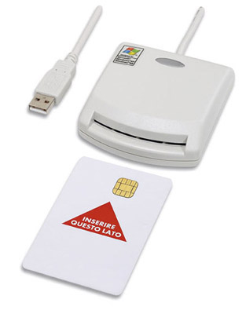
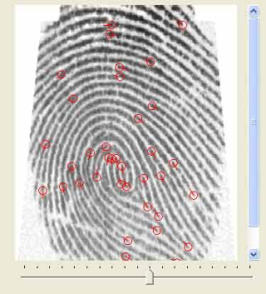
Solution (cont.)
Service vendors can use other security technology to provide a high degree of security protection
  Communication lock – unlock the account by user dialing to a special phone number.
  Smart card - contain volatile memory and microprocessor components that provides strong security authentication.
  Fingerprint – each one has his own fingerprint that cannot easily be forged.

Slide 42
Attack scenario
Burst force
Phishing
Sniffer
DDoS

Slide 43
Phishing
Phishing is a way of attempting to acquire sensitive information by a fake web page
  Cloned the normal web pages.
  Steal password or credit card account
There are three way of phishing
  URL Shortening
  A confusing link
  SEO (Search Engine Optimization) poisoning

Slide 44
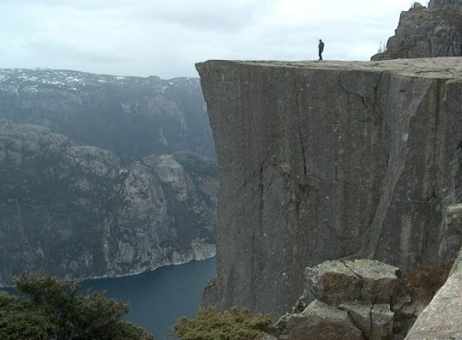


Phishing (cont.)
URL shortening is a technique on WWW in which URL may be made substantially shorter in length and still direct to the required page.
  Long URL cannot post in some forum, like Twitter or BBS.
  Trying to type long URL by hand will be time-consuming and result in errors.
  But short URL cannot determine the actual one or fake until link to.
www.shorturl.com/ABCEFG

Slide 45
Phishing (cont.)
A confusing link is a URL that replace the similar characters or use the same meaning words
  example.com vs examp1e.com
  www.candy.com vs www.candies.com
SEO (Search Engine Optimization) is the process of improving the visibility of a website in search engines.
  User usually find a website by search engine
  Hacker may poison SEO to increase the rank of phishing pages

Slide 46
In Cloud
Cloud vendor provides many services and many service webpages
  Users cannot remembers all of URLs
  Users may fall into phishing web pages
User can log in once and gain access to all services by SSO
  Reduce phishing success, and users are not trained to enter password everywhere.
  Each service can redirect to other service.

Slide 47
In User
User should be careful on account needing to be verified or any other topic used by phishing
User should improve concentration on detail of email
  All legitimate e-mail messages contain an item of information that is not readily available to phishers.
User can use plug-in or software to help identify legitimate sites

Slide 48
Attack scenario
Burst force
Phishing
Sniffer
DDoS

Slide 49
Communication
A packet is a formatted unit of data
  Computer communications links that simply transmit data as a series of bytes.
  A message would separate into several segment packets and each packet transmits to target computer.
  Receiver reconstruct message from these packets.
Each packets would pass through several computers and switches.

Slide 50

Sniffer
Sniffer means someone intercept and log traffic pass over a digit network or part of a network.
NIC(network interface card) drops any packet which receiver is not his MAC address
  NIC in promiscuous mode would not drop any packet.
  Hacker can get any packet pass through his NIC by setting promiscuous mode.

Slide 51
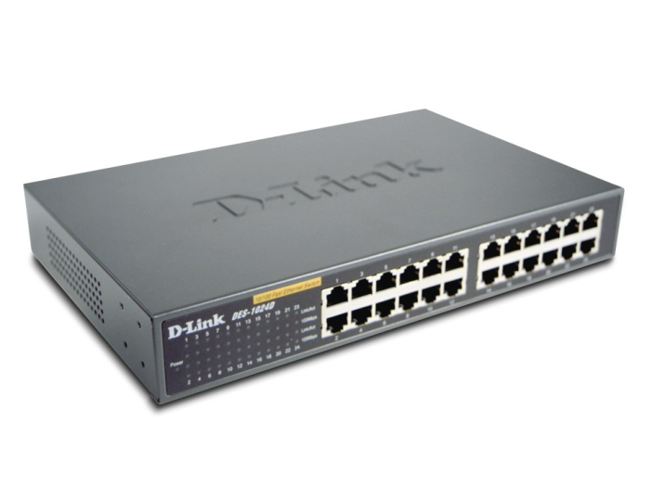
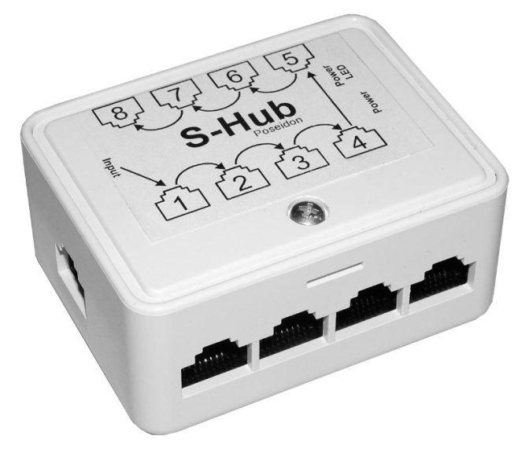
Network Device
In some network device, packets are redirect to other computer
  Hub connects multiple transmission cable together and make them act as a single network segment.
  Switch connects network segments and redirect packets into particular computer.

Slide 52
Network Device (cont.)
Hub works at the physical layer of the OSI model.
The device is a form of multiport repeater
  Receive a packet and broadcast out on all other ports.
  Hacker easy to get the packet in the same network.
Switch works at the data link layer of the OSI model.
Switch records MAC address by ARP protocol
  Redirect a packet to the particular computer by MAC route table.
  Hacker cannot get packet by using promiscuous mode.

Slide 53
ARP Spoofing
Switch uses ARP protocol to record the pair of MAC address and IP address
  Hacker uses ARP spoofing to attack a LAN (local-area network)
  Hacker send the ARP request and register his MAC address before the legal user.
  Hacker also can send lots of useless ARP request for DoS (denial-of-service) attack

Slide 54
VLAN switch
Using VLAN switch, user only can access switch and cannot connect to other users
In high-end device, switches can detect the ARP spoofing/attack and alert administrator the malicious behavior.
Switches can also set the static route table
  But in many case, the IP address would be dynamic decided

Slide 55
In Cloud
Cloud service venders limit the environment setting that can reduce the probability of sniffer.
Using SSL/TSL cryptographic protocols that provide communication security over the internet
  Even hacker getting the packet also cannot get the sensitive message.

Slide 56
Attack scenario
Burst force
Phishing
Sniffer
DDoS

Slide 57
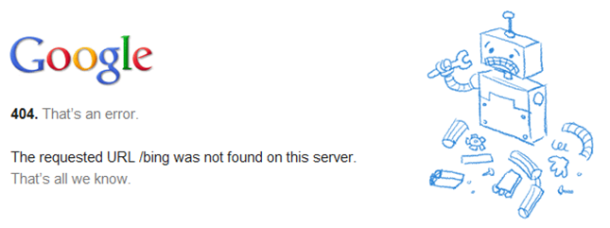
DoS
Denial-of-Service (DoS) is an attempt to make a computer resource (like storage service) unavailable
  Hacker send lots of request to server such that server cannot response to legal users.
Server can only provide services to fixed users
  Hackers account for all the resource as much as possible.
  Other users wait until server is available.

Slide 58
Attack
In general, a server can handle hundreds of requests at once
  A desktop can send hundreds of small request to attack a server.
  But in large-scale server, host can easily handle thousands to hundreds of thousands request.
  Hacker must need more resource.
DDoS (distributed denial of service) occurs when multiple systems flood the bandwidth or resources of a target system.

Slide 59
Botnet
Hackers want more resource to attack
  Hackers using Trojans and worms control lots of computers.
A botnet is a collection of compromised computers that are used for malicious purposes
  The average size of a botnet is estimated at 20,000 computers
  Hackers control compromised computers to send spam and DoS target.

Slide 60
In Cloud
Cloud computing provides service to many users
  One of the cloud properties is availability.
User access cloud service anytime and anywhere
  This means cloud platform must can service thousands of users.
  Cloud platform can distribute workload across multiple computers and services.
The general DDoS attack cannot affect the cloud environment.

Slide 61
In Cloud (cont.)
Cloud vendors offer pay-per-usage or pay-as-you-go access to computers and services.
Hacker may burn your quota
  DDoS may not affect the end user, but can increase the quota of usage of bandwidth.
  Hackers can send lots of query to increase spending of company

Slide 62
Real Case

Slide 63
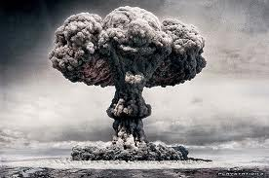
In the Real World
Cloud computing is providing services to users
  End users are using cloud benefits.
  Service providers are using cloud environment to provide service
Hackers are already to attack the cloud.

Slide 64
Zeus and Amazon
In 2009, the Zeus banking Trojan has been spotted using the Amazon service as a C&C (command and control) server.
  Compromised computers report to EC2 for new instruction and updates.
  Amazon’s Relational Database Service is a backend alternative in case losing access to original domain.
Crimeware will dive deep into the cloud.
  Facebook
  Google App Engine
  …

Slide 65
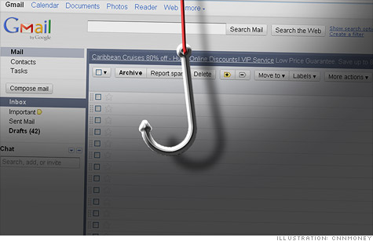
Google Phishing
In 2011, Google announced that hundreds of Gmail account were compromised in phishing
  Attackers have enough information to create an e-mail that seems like someone you know.
  Attackers try to stolen your password and access your e-mail account.
  Attackers secretly reset settings to copy and forward all e-mails.

Slide 66
Google Phishing (cont.)
Hackers attack Gmail to stolen the login details
  Senior US and South Korean government officials
  Chinese political activists
Chinese Gmail attack raises cyberwar tensions
  There is no direct evidence that the hackers were in the pay of the Chinese government.
  The US government classifies cyber-attacks as acts of war.

Slide 67
Wikileak and Anonymous
WikiLeaks is an international non-profit organization
  publishes submissions of private, secret, and classified media.
  under DDoS attack around the time of an expected release of classified State Department documents.
WiliLeaks want to move into Amazon EC2
  EC2 were successfully defended against large-scale DDoS attack.

Slide 68
Wikileak and Anonymous (cont.)
But in 2011 December, many cloud computing providers stop service for WikiLeaks
  EveryDNS dropped its domain name service.
  Amazon took it off its computers.
  PayPal and MasterCard cancelled its account.
Anonymous (hacker group) attacks on the opponents of WikiLeaks
  PayPal and MasterCard are forced to stop online service.
  But hackers stop attack Amazon because realizing how little impact it was having.

Slide 69
Dropbox Security
In 2011, Dropbox security glitch meant any password works
  Everyone can access dropbox if he know the e-mail.
  Dropbox’s authentication is failed in one hour and stop service for up to three hours.
Dropbox claims that they encrypt user data on client
  In fact, workflow of encryption is on server.
  Staff could access the sensitive data.

Slide 70
Summary
Cloud computing provides a new service model
  A way to increase capacity or add capabilities
  Need not a new infrastructure, t raining new personnel, or licensing new software.
Cloud computing also becomes a big target for malicious attackers.
Hackers try to access computer, stolen data and destroy system
  Everyone would be the victim.

Slide 71
Summary (cont.)
According to the principle of CIA, cloud computing vendor need to provide a safe, secure and reliable environment.
  Increase the accessibility and availability and reduce the inconvenient on usage.
  Protect data and avoid to be stolen.
  Analysis and trace the security event, improve system security at any time.

Slide 72
Reference
Wikipedia http://en.wikipedia.org/wiki/Wiki
News
  http://www.zone-h.org/
  http://www.zdnet.com.tw/news/software/0,2000085678,20143834,00.htm
  http://udn.com/NEWS/WORLD/WOR3/6025617.shtml
  http://tw.nextmedia.com/rnews/article/SecID/109/art_id/42470/IssueID/20110623
  http://lieberman.senate.gov/index.cfm/news-events/news/2010/12/amazon-severs-ties-with-wikileaks
All resources of the materials and pictures were partially retrieved from the Internet

